Slide 1
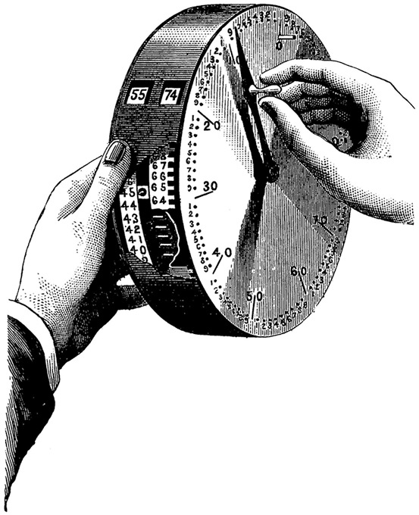
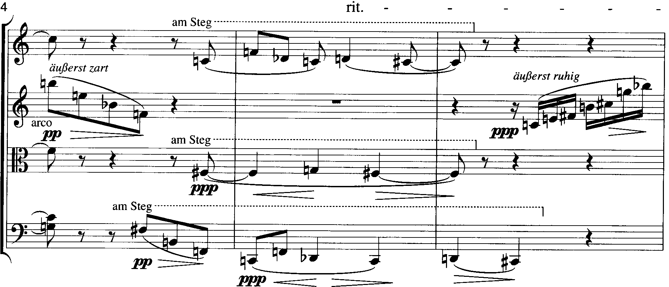
Twelve-tone Principles

Slide 2
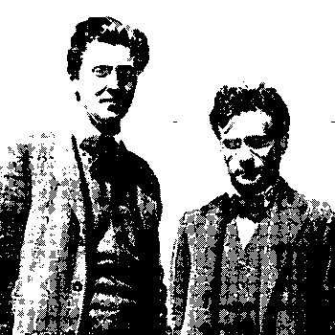
Basic Principles
A row or series is an ordered pitch-class collection
Each pc has an order number (finding them called a „twelve count”)
Four canonic forms

Slide 3
Some texts begins the twelve-count at 0, not 1.

Slide 4
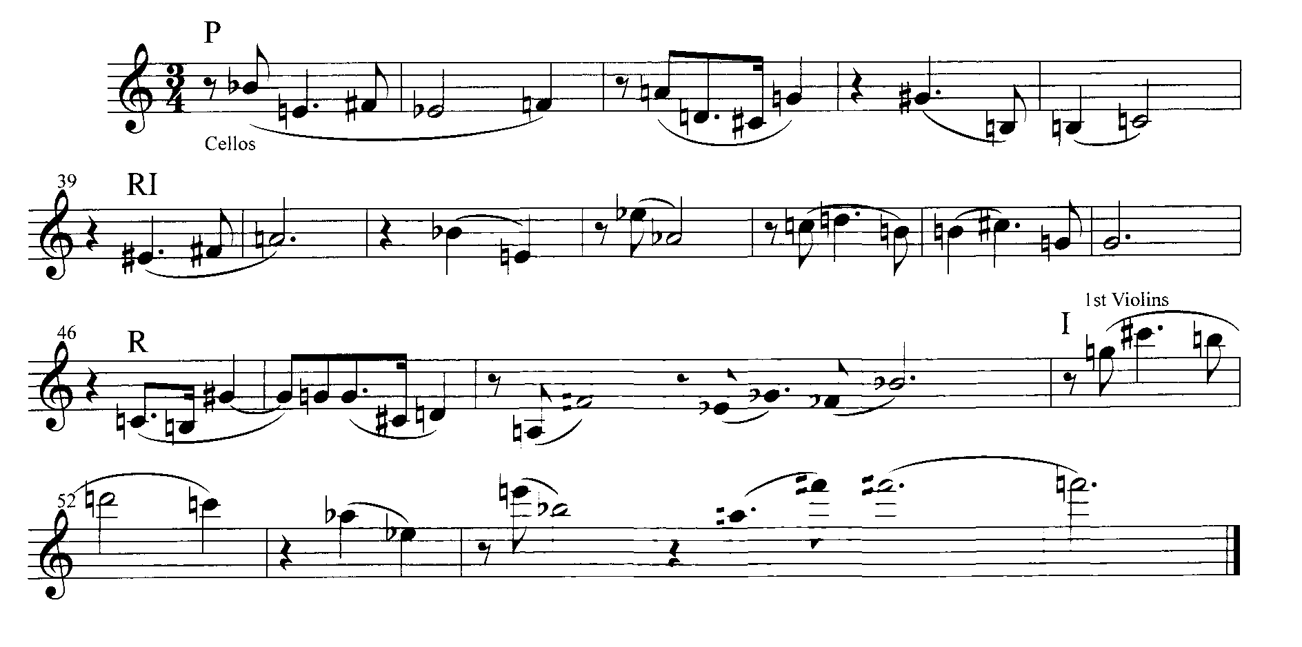
Schoenberg Variations for Orchestra, Op. 31, mm. 34-57

Slide 5
Schoenberg Variations for Orchestra, Op. 31, mm. 34-57
1 2 3 4 5 6 7 8 9 10 11 12
1 2 3 4 5 6 7 8 9 10 11 12

Slide 6
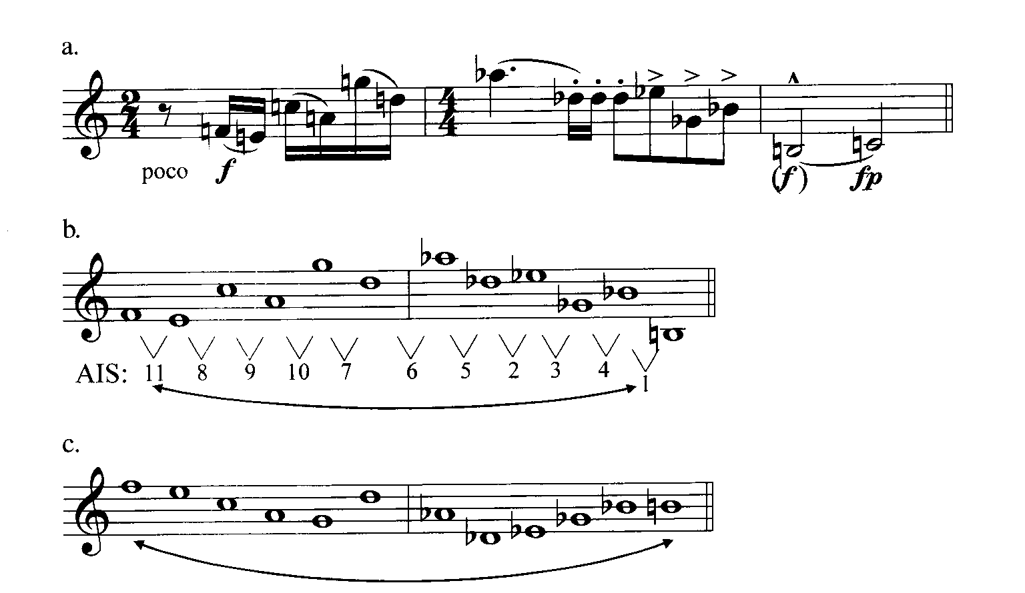
The AIS: All-Interval Series

Slide 8
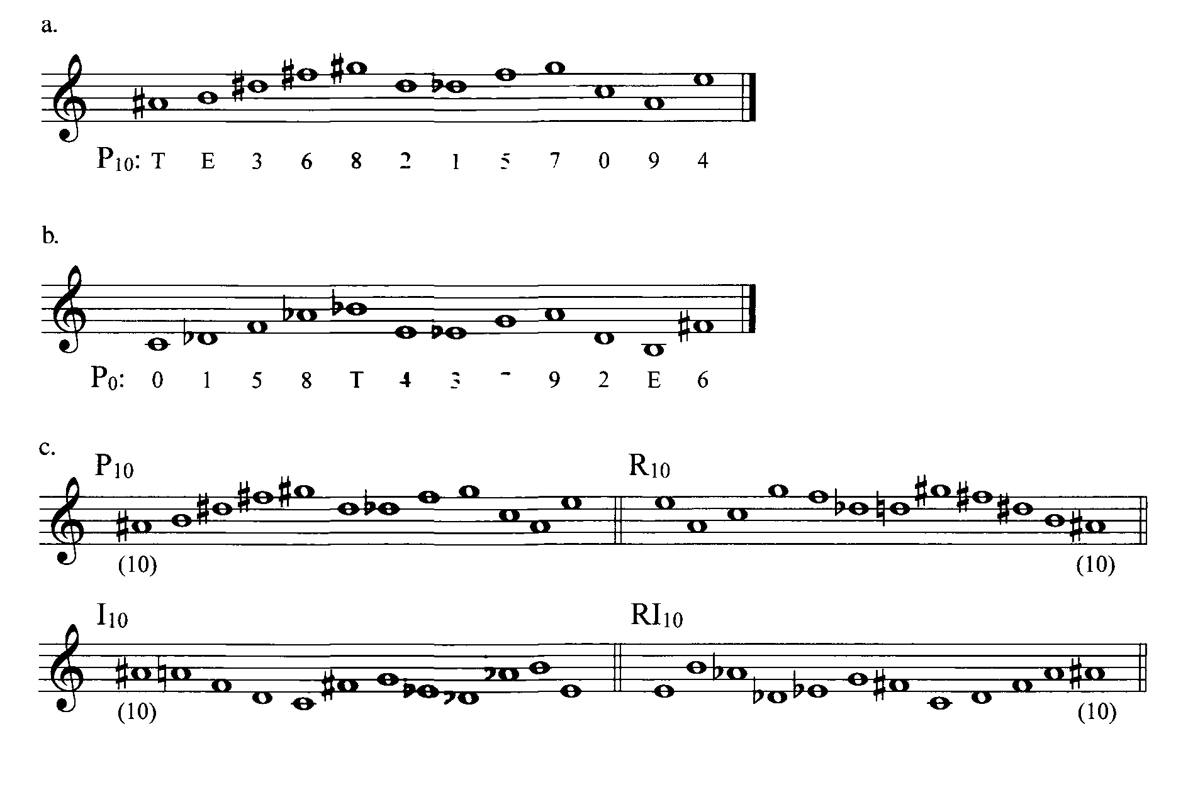
Labeling Row Forms

Slide 9
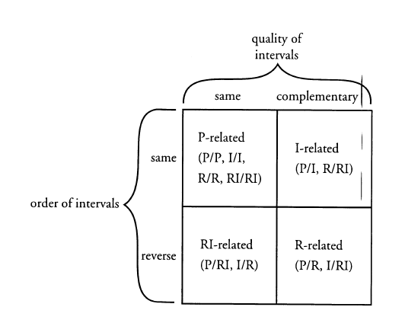

Slide 10
Transposing a Row
P₀ | 0 | 1 | 5 | 8 | T | 4 | 3 | 7 | 9 | 2 | E | 6
add | 11 | 11 | 11 | 11 | 11 | 11 | 11 | 11 | 11 | 11 | 11 | 11
P₁₁ | E | 0 | 4 | 7 | 9 | 3 | 2 | 6 | 8 | 1 | T | 5

Slide 11
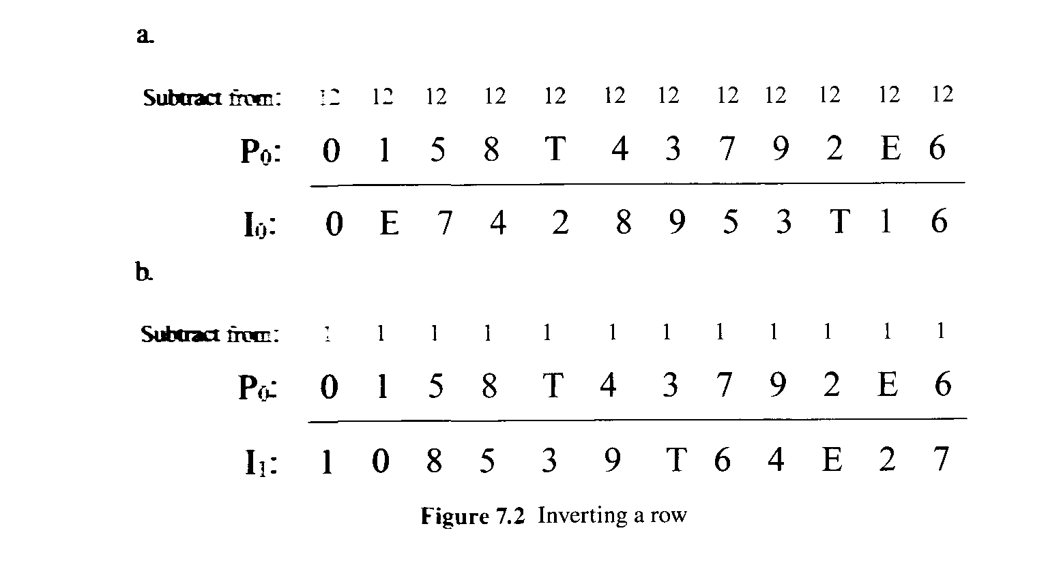
Inverting a Row

Slide 12
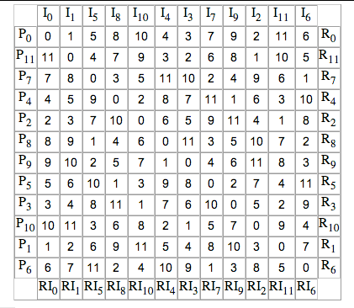
Building a Twelve-tone Matrix

Slide 13
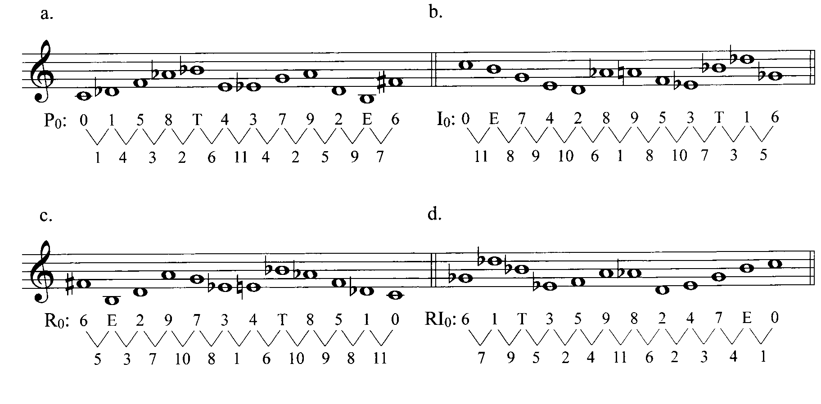
Interval content for Dallipiccola’s row

Slide 14
Identifying Row forms without the Matrix
Calculate the AIS of P₀
The intervals for I₀ forms are the same as for P₀, but the contour is reversed
Therefore I₀ is the inversion (mod 12 interval complement) of P₀
Note that R₀ is not only backwards, but also relies on the mod 12 complements of the corresponding intervals in P₀
And RI₀ becomes the reverse of the actual intervals in P₀

Slide 15
The Sample row AIS: <1-4-3-2-6-11-4-2-5-9-7>
AIS for I forms: <11-8-9-10-6-1-8-10-7-3-5>
AIS for R forms = mod 12 complement of retrograded intervals for P forms = AIS for I backwards: <5-3-7-10-8-1-6-10-9-8-11>
AIS for RI forms = retrograded intervals for P forms: <7-9-5-2-4-11-6-2-3-4-1>

Slide 16
Row form ID: 1
Sample row AIS: <1-4-3-2-6-11-4-2-5-9-7>
Opening pcs 2, 1, 9, 6
AIS <11-8-9>
I₂

Slide 17
Row form ID: 2
Sample row AIS: <1-4-3-2-6-11-4-2-5-9-7>
Opening pcs 5, 6, T, 1
AIS <1-4-3>
P₅

Slide 18
Row form ID: 3
Sample row AIS: <1-4-3-2-6-11-4-2-5-9-7>
Opening pcs 8, 1, 4, E
AIS <5-3-7>
R₂

Slide 19
Row form ID: 4
Sample row AIS: <1-4-3-2-6-11-4-2-5-9-7>
Opening pcs T, 5, 2, 7
AIS <7-9-5>
RI₄

Slide 20
Row form ID: 1
Schoenberg, 4th Quartet: 0 E 7 8 3 1 2 T 6 5 4 9
R₈

Slide 21
Row form ID: 2
Schoenberg, 4th Quartet: 0 E 7 8 3 1 2 T 6 5 4 9
I₀

Slide 22
Row form ID: 3
Schoenberg, 4th Quartet: 0 E 7 8 3 1 2 T 6 5 4 9
RI₉

Slide 23
Row form ID: 4
Schoenberg, 4th Quartet: 0 E 7 8 3 1 2 T 6 5 4 9
P₆

